Slide 1
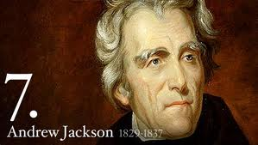
I. The Age of Jackson 1824-1840

Slide 2
A. Era of Good Feeling
One political party: Democratic Republican
Henry Clay’s American System
Make money more accessible
Create tariffs to protect American industries
Fund infrastructure
Created the largest economic boom in American history, however this will also create
Creates Sectionalism
Strengthen the military
Rise of Nationalism
North and West will love this system
South will not
Monroe Doctrine

Slide 3
B. Election of 1824 1. An election dominated by Sectionalism
John Quincy Adams
MA
North
William Crawford
GA
South
Henry Clay
KY
North West
Andrew Jackson
TN
South West

Slide 4
Compare Jackson to Adams

Slide 5
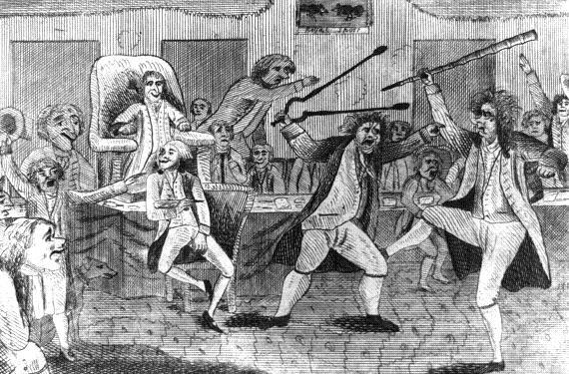
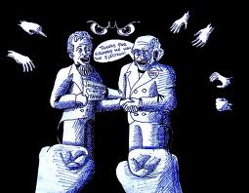
2. Election Results
No one reached enough electoral votes to win
Sent to the House of Representatives according to the Constitution.
Only the top 3 could now be president.
Henry Clay, Speaker of the House, used his influence to elect John Quincy Adams

Slide 6
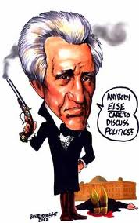
Once president, Adams hired Henry Clay to be his Sec. of State.
Many assumed Clay sold his influence to Adams so he could be secretary of state (increases his chance of being president)
Jackson accused the two of a “Corrupt Bargain”
Jackson spent the next four years preparing for the next election.

Slide 7
Changes in the Democratic Process called Jacksonian Democracy
Change 1
Many states changed their land ownership law in order to vote.
Change 2
Ended many restrictions on voting i.e...
Poll tax
Literacy test
Change 3
Created nominating convention to select presidential candidates. Now average citizens could have a voice.

Slide 8
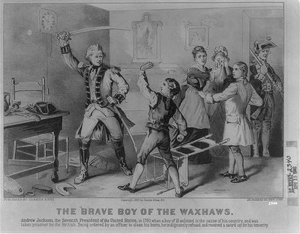
Election of 1828
Democratic Party arose from Jackson supporters.
Selected John C. Calhoun of SC for Vice President.
*For full southern support
Adams accused of being Rich, out of touch with everyday people
Jackson accused of murder of deserters, dueling and adultery: Hot tempered, crude, and not having the temperament to be president
Tariffs were the only real issue of the election
Supported tariffs
Against tariffs

Slide 9
Compare Jackson to Adams

Slide 10
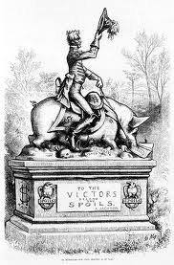
III. Jackson’s Presidency
Seen a victory for the common man
Jackson rewarded his supporters with government jobs
Spoils System.
Kitchen Cabinet – a group of informal advisors that met in the white house kitchen.

Slide 11
C. Sectionalism Grows
1. North
Manufacturing economy
Supported tariffs to protect American Goods
2. South
Agricultural economy
Opposed tariffs. Raised the price of their goods.
3. West
Emerging economy
Supported internal improvements: roads, canals.
Supported the sale of public lands
Opposed expanding government

Slide 12
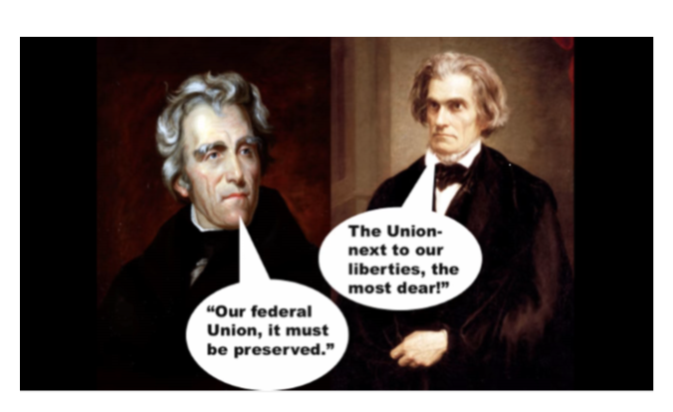
E. Sectionalism Grows
1. Tariff of Abominations
North asked to a tariff on woolen goods to protect America’s wool industry.
VP John C. Calhoun – despised the tariff system
Tariff of 1828 AKA Tariff of Abominations
2. 1832 – Congress passed another tariff
South Carolina passed the Nullification Act
Threatened to secede
SC thought other states would follow
Jackson passed a force bill - brought up the federal troops
Henry Clay compromise reduced tariff
SC repealed the Nullification Act
3. Importance -

Slide 13
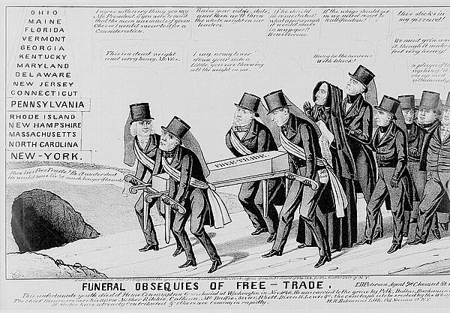
Tariff of Abomination – Death of Free Trade

Slide 14
F. Jackson’s War on the Bank of the United States
Jackson said that he will do “What is right and just.”
The Bank of the United States – not in the Constitution
Bank decided how much money the states received
Nicholas Biddle
Enemies with Jackson over which banks would receive federal dollars
Election of 1832
Jackson vetoed the Bank bill just before the election
Jackson won the election – landslide again
Sec. Of Treasury – Roger Taney put money in certain state banks called Pet banks
Then Biddle restricted the flow of currency
1836 Bank of the United States went out of business
Henry Clay runs in favor of the Bank
President of the US bank
The Panic of 1937 was created, sending the US back to a barter system.

Slide 15
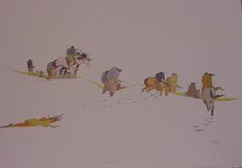
D. Indian Removal Act
5 Civilized Tribes” Seminole, Cherokee, Choctaw, Chickasaw, Creek
US had policy supporting white settlers taking Indian lands
Gold found on Indian lands
Indians were trying to gain ownership of their land through the courts
Supreme Court sided with the Cherokee in Worchester vs. Georgia
1. Sided with the Native Americans (Chief Justice John Marshall)
Jackson ignored the Supreme courts decision – checks and balances
“for their protection”
Indians refused –The army sent to Force them
Trail of Tears – Fall & Winter of 1838

Slide 16
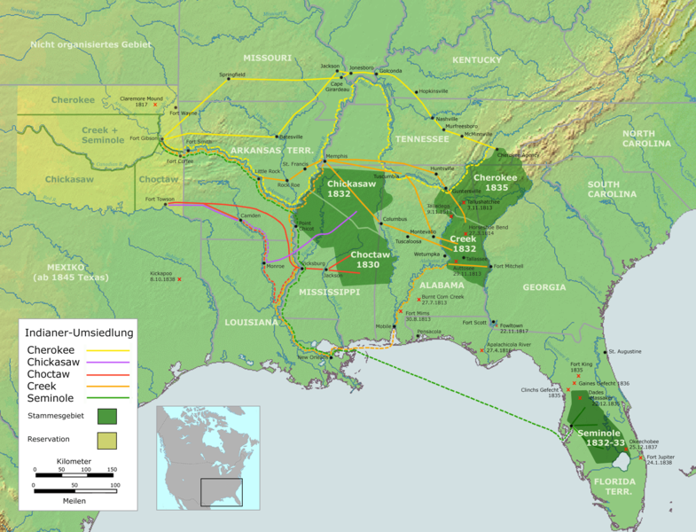
Indian Removal Map

Slide 17
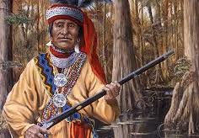
G. Indian Reactions
Some went to their new lands without a word.
Cherokee set up a constitution and elected representatives government
Some native Americans used the US courts to sue for their rights
Refused to leave their homes
Seminoles fought
Osceola fought in Florida for seven years
Never did catch all the Seminole and their descendants still live in the swamps today.
Sequoya – created a written language for the Cherokee and set up a newspaper to inform the citizens of the US the true story of the Cherokee.

Slide 18
End of the Age of Jackson
Out of eight hundred and fifty banks, three hundred and forty-three closed entirely, sixty-two failed partially ,and the system of State banks received a shock from which it never fully recovered
Election of 1836
Jackson used his influence to pick Martin Van Buren
Republicans were seen as a rich party renamed themselves
Whigs ran three candidates against Van Buren
Tried to split the vote and take the election to the House of Reps
Panic of 1837
Many banks loaned and print money too freely
With money easy to get, speculators bought w/ credit
$$ became worthless
Banks took many properties & couldn’t sell the land
People rushed to exchange money for specie
The price of cotton dropped in the south and flood wiped out the wheat in the west
Demand for goods decreased
Factory laid off workers
Many people became homeless
Election of 1840
Landslide for the united Whig candidate William Henry Harrison
Slogan “Tippecanoe and Tyler too”

