Slide 1
Review :
What was the importance of the War of 1812?
help the development of America’s national unity?
Confirmed American independence
We beat the British again
Strengthened nationalism
Battle of New Orleans (Jackson = national hero)

Slide 2
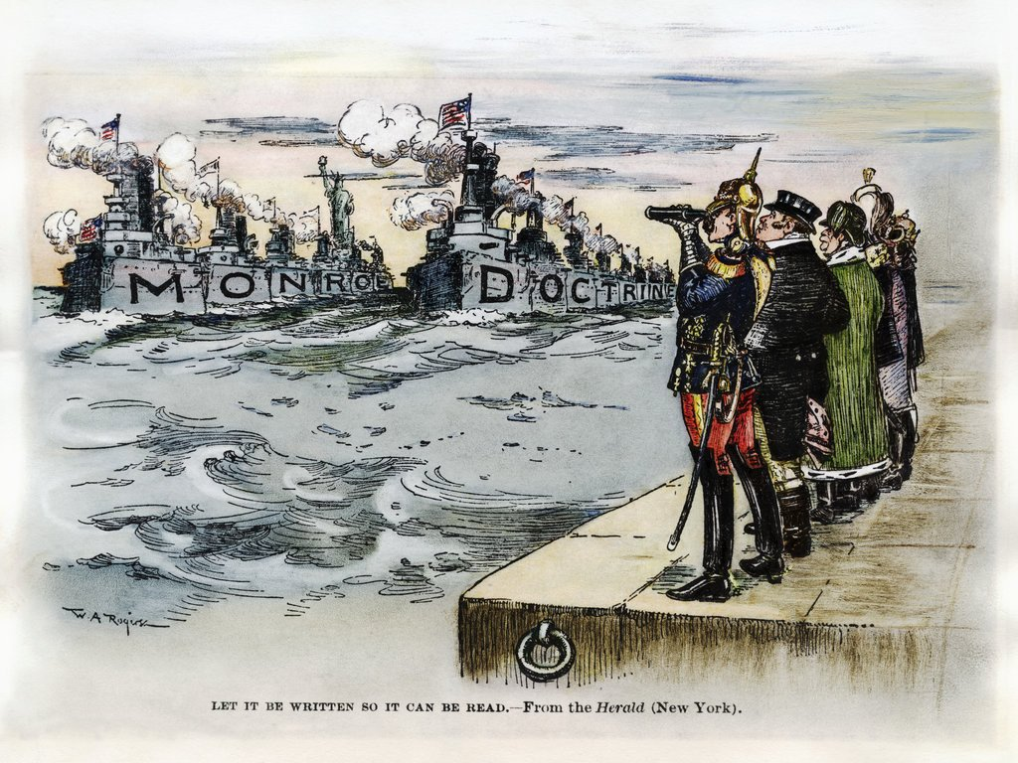
I. The Monroe Doctrine

Slide 3
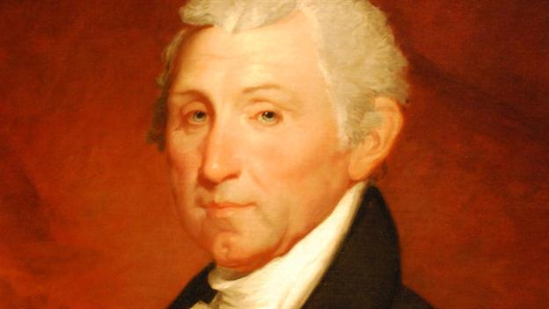
The years after the War of 1812 are called the “Era of Good Feelings”
James Monroe was elected President of the US. In 1816
Last of the Revolutionary Presidents

Slide 4
Monroe Doctrine
Meanwhile, the European powers finally defeated Napoleon and wanted to reclaim colonies in Latin America
France, Germany, Russia, Spain, Portugal
The U.S. also felt threatened by Russia from the Northwest
Russia expanded from Alaska and built trading posts in what is now California

Slide 5
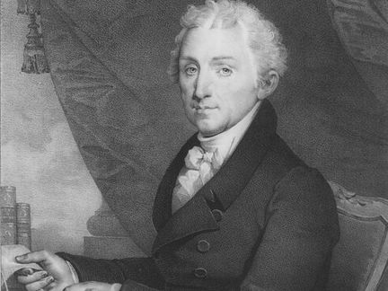
In 1823 President Monroe gave a speech that later became known as the Monroe Doctrine

Slide 6
Monroe Doctrine
Warned European powers not to interfere in the Western Hemisphere
Do not try to make new colonies or try to overthrow newly independent republics --> he warned that the US would consider this “dangerous to our peace and safety”
Likewise, the US would not get involved in European affairs or interfere in existing colonies
4. Great Britain supported the Monroe Doctrine and became the best ally in Europe.

Slide 7
Why is the Monroe Doctrine important?

Slide 8
Shapes foreign policy
An example of American nationalism
The Monroe Doctrine is still US. Policy today.

