Slide 1
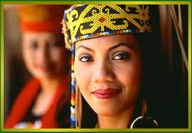
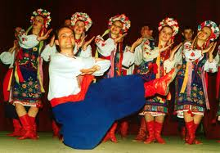
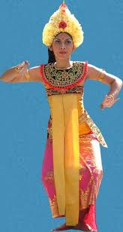
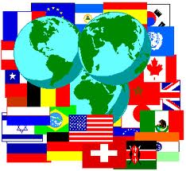
Culture

Slide 2
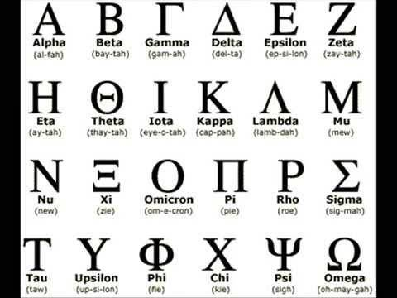
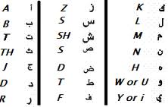
I. Characteristics of Culture
Language – The method of human communication, either spoken or written, consisting of the use of words in a structured and conventional way.

Slide 3
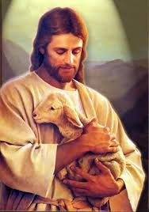
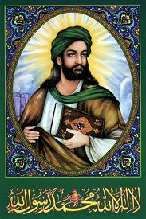
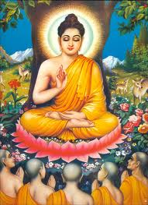
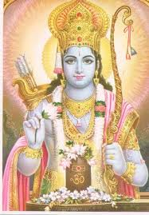
Characteristics of Culture
Religion - The belief in and worship of a superhuman controlling power, esp. a personal God or gods

Slide 4
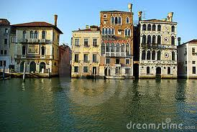
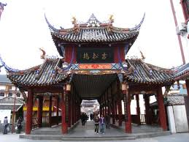
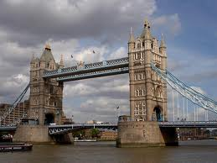
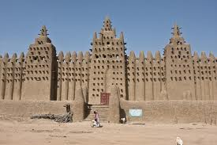
Characteristics of Culture
Architecture – the collective character or style of building:

Slide 5
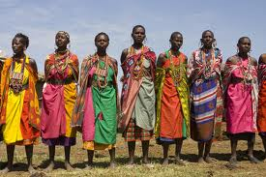
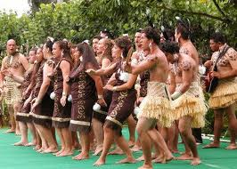
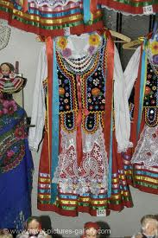
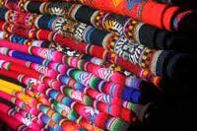
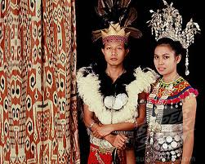
Characteristics of Culture
Clothing – unique garments worn collectively as a people.

Slide 6
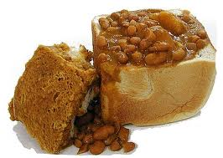
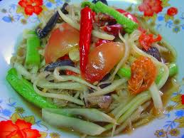
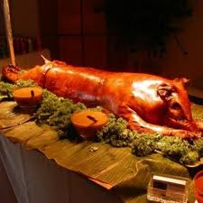
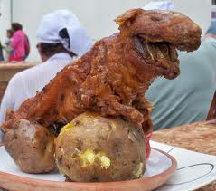
Characteristics of Culture
Food - any nourishing substance that is eaten, drunk, or otherwise taken into the body to sustain life, provide energy, promote growth collectively.

Slide 7
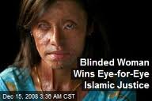
Characteristics of Culture
Government - the political direction and control exercised over the actions of the members, citizens, or inhabitants of communities, societies, and states;
Democratic Government
Totalitarian Government

Slide 8
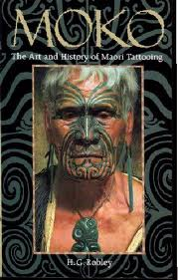
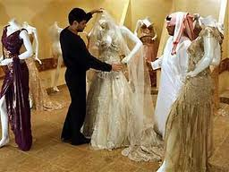
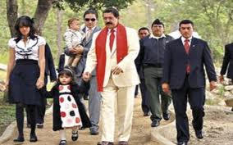
Characteristics of Culture
Family Life – A set of norms that most a population follows at the family level of living.
Number of people who live in house
Responsibilities of each family members.
Who to marry
What is normal

Slide 9
Characteristics of Culture
Economics - the management of the resources of a community, country, etc., especially with a view to its productivity.
Traditional – choices made by old customs
Market – buyers make the choices
Command – government makes choices
Mixed – blend of Market/Command
Most economies in the world are mixed includeing the United States.

Slide 10
II. Culture Traits
Traits are shared activities and behaviors of a people
utensils to eat with varies in cultures
traits are linked to
Islam - no pork no alcohol
Judaism – no pork wine allowed
Hog farms in the middle east? Israel yes because Judaism is the Religion
culture traits change through time
1. Clothes – 40’s, 50’s, 60’s, 70’s, 80’s, Now
2. The way we shop. 50’s Mom and Pop, Wal-Mart and ecommerce today
3. Transportation

Slide 11
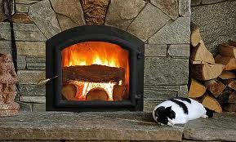
III. Cultural Hearths
An area with many shared cultural traits is called a Culture Region.
Theses regions can create many ideas and innovations.
Cultural Hearth – a region where important new ideas and innovations originate.
These ideas then travel to other cultures and they adopt that element for their own called diffusion.
Examples
Democracy invented in ___Greece____
Wheel invented in ___Mesopotamia____
Gunpowder invented in ___China_________
Other examples Automobile, Factory system, iPhone
Domestication of Wheat

Slide 12
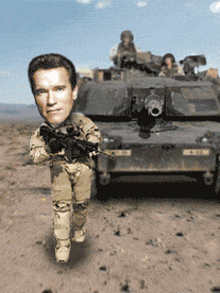
IV. Cultural Conflict
Traditional vs. Modern
Change that occurs within a culture
Nationalism
A feeling of pride in ones nation; We are better than you
Religion –
When people believe one religion is the correct religion
Politics
Democratic vs. totalitarian – never in the history of man has two democratic nations ever go to war with each other
The United Nations is designed to solve problems and reduce conflict
Natural Resources
Finite number of resources in this world
Superpower colonize less developed nations, then conflict emerges over the land and its resources; Japan attacked Pearl Harbor because of __OIL and Metal___?
The Crusades
However: Extreme example: Germany WW II
The counterculture of the 1960’s
The Cold War( Vietnam, Korea)
Al Qaeda
Healthy for a country

