Slide 1
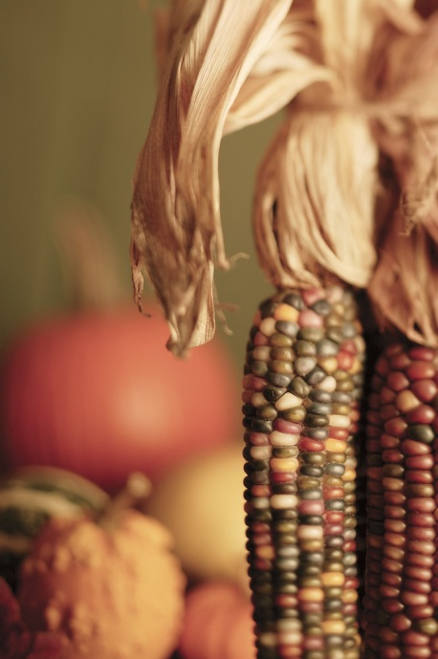
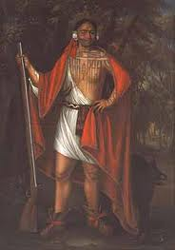
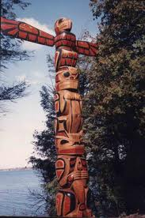
The First Americans
Pre-History to 1492

Slide 2
People Arrive in the Americas
People Arrive in America
25,000 years ago – 8,000 BCE
Bering Strait
Ice age
Hunter-gatherers –
wooly mammoths, oxen, saber-tooth cats
seeds, berries, nuts, roots, and bulbs
End of the Ice Age 10,000 yrs ago
Large animals become extinct
Had to fish and hunt smaller animals, and fish
Began to build sturdy, permanent shelters, stored foods

Slide 3
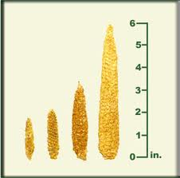
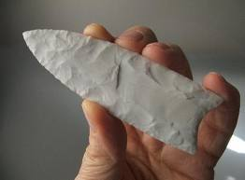
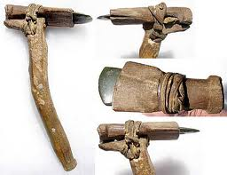
First Farmers
7,000 B.C. experimentation w/ plants / simple gardens
Central Mexico
wild grain – maize
Beans and squash
Archaeologists - Examining the Evidence
Carbon Dating
Stone Spearheads
Clovis New Mexico 11,000 yrs. old
oldest artifact in US
Canada - Old Crow River Valley
Carved Bone 27,000 yrs. Old
Use unknown

Slide 4
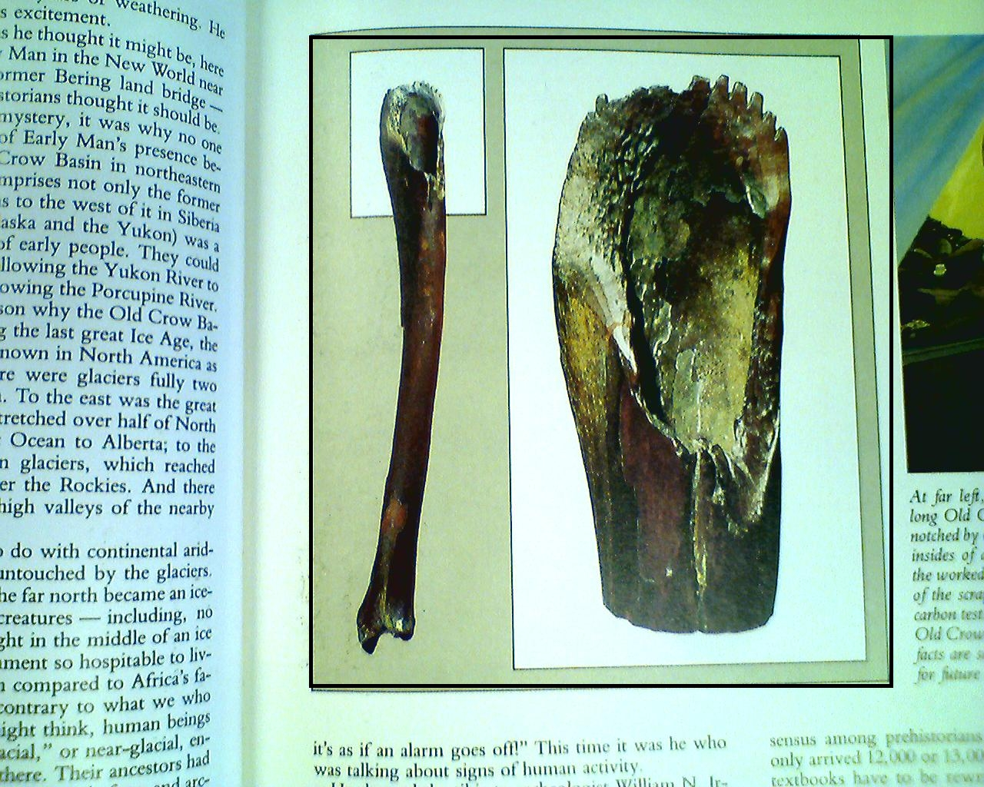
What was this carving used for?

Slide 5
Major civilizations in North America
culture – a total way of life a people follow to satisfy their wants and needs
2000 yrs. ago
Mound Builders – up to 100 ft. high, covers 16 acres
Why did early native build mounds?
What artifacts have been found within the mounds?

Slide 6
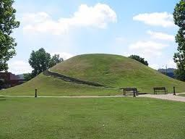
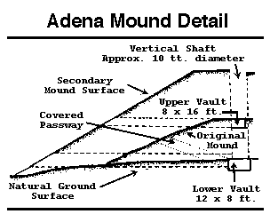
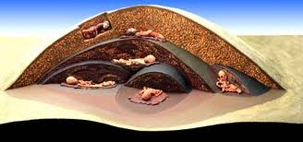
Three mound-building cultures
Adena – Ohio, West Virginia pic p.42
  sunflowers, pumpkins, tobacco
  mainly hunter-gatherers
  food plentiful

Slide 7
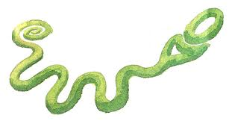
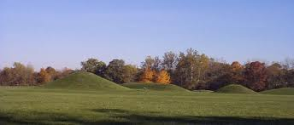
Three mound-building cultures
Hopewell – WV, OH, IN, MO, WI, IO, MI
  relied heavily on farming
  earthworks larger, art more advanced
  large trade network
    sea shell from Atlantic
    silver from Canada
    Alligator from Florida
    Volcanic glass from Wyoming
500 A.D. both civilizations disappeared – cause unk

Slide 8
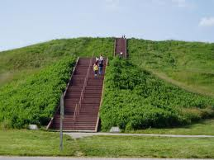
Three mound-building cultures
Mississippian Culture – developed 700 A.D
most advanced of all mound builder
Settled near rivers – why?
Kept livestock, farmers: corn, beans, squash, pump
Traded w/ Central America
Cahokia Mounds – 40,000 pop
Over 100 mounds
Disappeared about 1500 A.D
The first Spanish explorers reported only one group

Slide 9
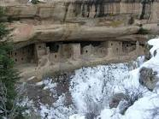
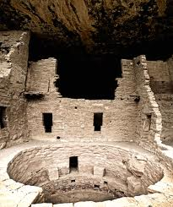
Cliff Dwellers
– AKA The Anasazi
AZ, NM, UT, CO
built houses on the walls of cliffs, overhangs of caves
100-1300 A.D
Adobe – straw, earth
Kiva – a ceremonial structure usually round partially underground
Pueblo – stone, timber, adobe
Small apartment homes on top of each other
Connected by ladders
Protection from invaders? Unk
Corn, squash, beans, tobacco, cotton
Artistic pottery and jewelry

Slide 10
