Slide 1
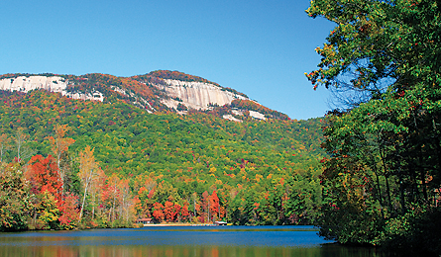
Table Rock State Park!

Slide 2
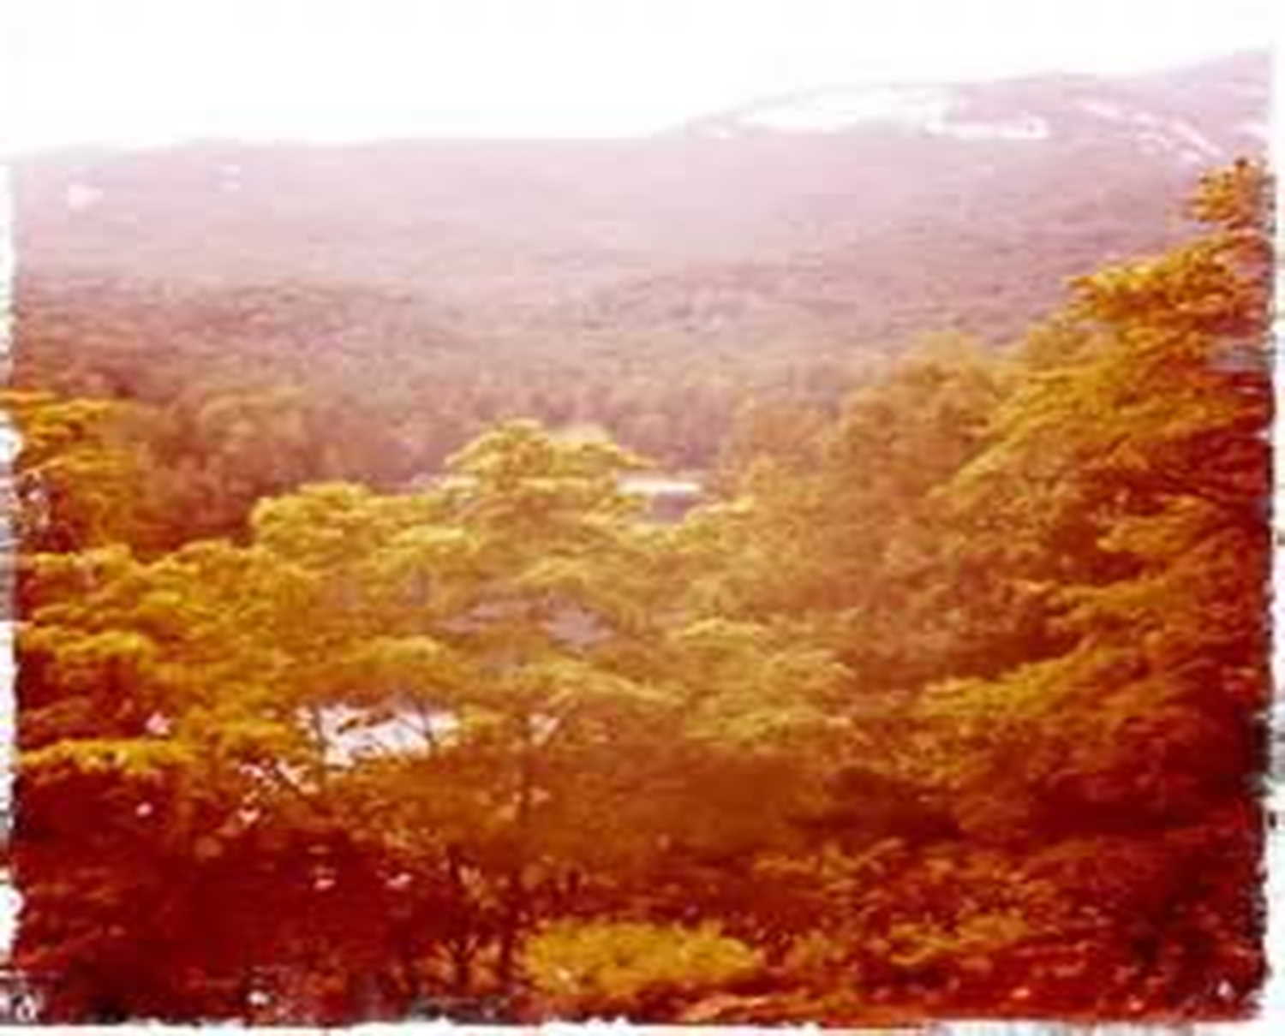
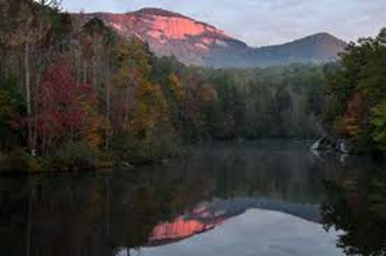
Location
State: Missouri
City: Branson
Exact Location: 36 34’55.73”N, 93 18’32.85”W

Slide 3
Table Rock State Park
Nestled in the oak and hickory trees that surround Table Rock Lake, Table Rock Lake State Park offers something for everyone. Camping areas that allow easy access to the lake. A marina that rents all manner of boats. SCUBA diving excursions. A mountain bike trail. Easy access to the Branson area and all its entertainment. Shelters and picnic areas and a full range of campsites help make Table Rock State Park the ideal place for playing in and around the lake’s clear waters.

Slide 4
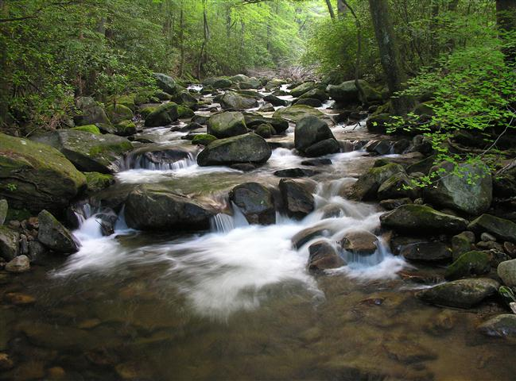
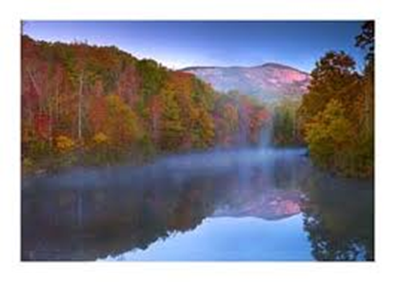
Rare Features.
Table Rock state park has bald eagles, which are going extinct, also Table Rock has many wildflowers that are dying because of humans. Table rock also has many geological features, that’s where its name came from, the table rock. There is beautiful views and vast lands in Table Rock, too.

Slide 5
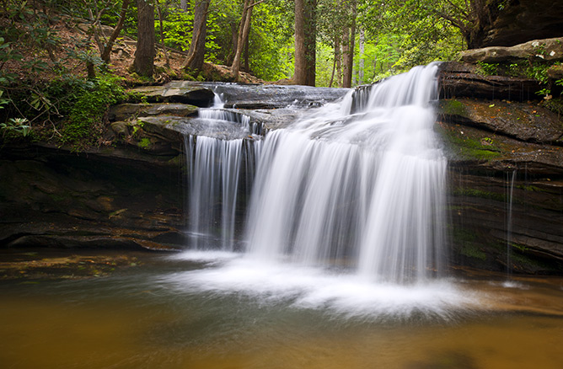
Plants and Animals
A variety of wildlife inhabits Table Rock State Park. Animals such as white tail deer, wild turkey, red fox, gray fox, tarantulas, song birds and glade wildlife live in and around the state park. There are also many native plants including glade plants, wildflowers and riparian plants.

Slide 6
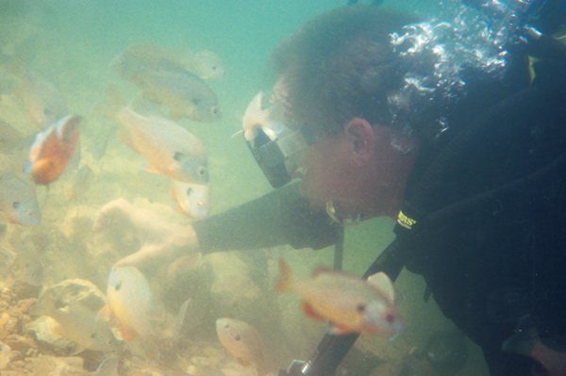
Activities
You can visit the gift shops and site building, plus you can rent a cute cabin.
Table Rock state park has many activities for everyone, there’s hiking and scuba diving, fishing, cave tours, floating, swimming, boating, site tours, bicycling, camping, horse back riding, ATV riding, metal detecting, dining, picnicking, playgrounds, and I’m sure there’s more.

