Slide 1
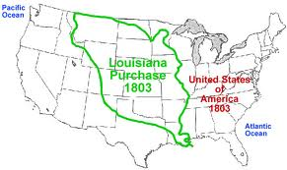
Louisiana Purchase Notes
Ch. 11

Slide 2
Jefferson Takes Control
First time in modern history that a peaceful transfer of power from one party to another without violence.
Called for unity “We are all Federalists, we are all Republicans.”
Laissez-faire government
Cut the army to 2500 men, and the navy to from 25 to 7 ships
Cut all government spending and size by ½
Repealed the Whiskey Tax
Repealed the Alien Sedition Act

Slide 3
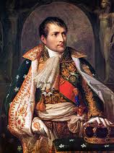
Louisiana Purchase
Louisiana Purchase 1803
Importance of Miss. R. and New Orleans
Spain occasionally closed New Orleans due to illegal American immigration.
? What reasons did Spain shut down New Orleans during the colonial period?
Cede to France
Napoleon Bonaparte plans for Louisiana = Empire in the West
? What if Napoleon would have created his empire in the Americas?
Jefferson sends Monroe to France to buy New Orleans and West Florida
Authorized by a bill to spend up to $10 million
Doubled the size of the US in one stroke of the pen.
? Under Strict Construction, what If Napoleon wants more money?

Slide 4
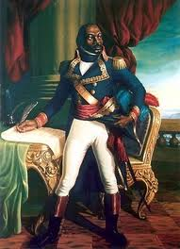
Revolution on Haiti
Toussaint Louverture Rebel leader in Haiti
A prolonged rebellion in which Napoleon needed
more than 30,000 troops to put down.
Revolution became Too costly and War broke out with England again
needed money
France told Monroe would sell all of Louisiana for $15 million
What if there was no rebellion in Haiti? Would Napoleon want to sell?
Strict Interpretation and the land purchase
Jefferson finally decides to accept the purchase and immediately creates a corps of discovery to examine his purchase.

Slide 5
The Corps of Discovery Apr.1804 – Sept. 1806
Lewis and Clark – equal partners in the expedition.
Jefferson gave Lewis specific instructions:
Find the source of the Missouri River.
Find a usable route across the Rocky Mountains
Observe the customs and politics of the Native Americans
Note features of the land(map), and the weather
Document plants and animals of the region
Lewis -
Clark
Why do you think Lewis chose Clark for this expedition?

Slide 6
Zebulon Pike Expedition
Find the source of the Mississippi R.
Explore the southern portion of the Louisiana Purchase
Told to Spy on the Spanish in the region(Santa Fe) by General Wilkerson
Captured and sent back to US. After gaining the Intel he was sent for.
Reported he did, but was a mistake
Down the Red River to Colorado
Dubbed the Louisiana Purchase the “Great American Desert”
By Aaron Burr
How do you think US migration patterns would have been affected by this statement?
Negotiated a peace agreement between two native tribes
Discovered Pike Peak

