Slide 1
Current River Soon Becoming Missouri 1st State Park
By: Aaron Land
&
Evan Howard

Slide 2
Fun Activities to do at the Current River
Tubing
Kayaking
Canoeing
Horse back riding
Fishing
Swimming

Slide 3
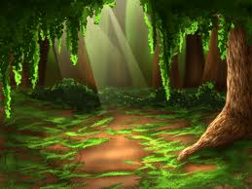
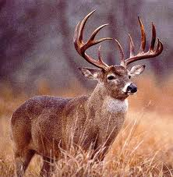
Animals
White tailed deer
Snakes
Raccoons
Fish
Birds
Opossums
Craw Dads
Lizards
Wild Turkey
Hellbenders
Squirrels
Chipmunks

Slide 4
Plants
Big Blue Stem, and Fescue Grass
Poison Sumac, and Poison Ivy
Oak trees
Moss
Briers

Slide 5
Why it Should Be a National Park
It should be a national park because it has natural beauty, culture, recreational resources, events, activities, and because of its river.

Slide 6
The Downside to the Current River
People are polluting it by riding their four wheelers. They are destroying trails, and littering. And the Hellbender is becoming endangered from the pollution.

Slide 7
The New Current River
The current river should be brought back to the way it was before. It should stop being polluted because it is destroying the current river. And if it were to stop then it would become the way it was before.

Slide 8
Location
The absolute location of the Current River is

