Slide 1
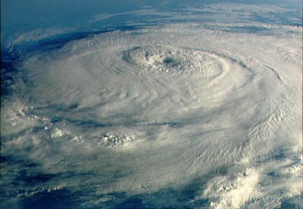
The Earth’s Climate and Atmosphere
Global Energy System
Atmospheric Effects
Global Climates

Slide 2
Global Energy System
Weather vs. Climate
Weather is the condition of the atmosphere of a at any given time.
Climate is weather averaged over a long period of time.
The Greenhouse effect – Global Warming Quiz
Why doesn’t the equator region boil because of the sun?
How does the world temperature balance work?

Slide 3
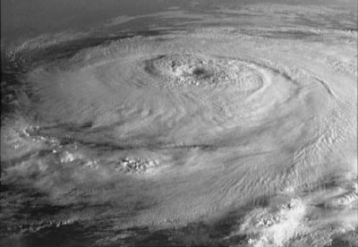
Air Pressure and Wind
The force exerted by air is called air pressure
Air pressures creates winds and ocean currents
Hot air _________________.
Cool air _________________.
Wind always flow from high to low pressure.
Click on picture to answer the following question.
Determine the relationship between atmospheric pressure and altitude.?
Determine the relationship between temperature and altitude.?
Determine the location of ozone in the Earth’s atmosphere?

Slide 4
Air Pressure makes wind and storms(Cont.)
How does pressure change when a large storm passed overhead? See here
Why is there always wind on the ocean next to land? See here
Most rain storms in the Equatorial region occurs like this. See here
Most rain storms in the temperate zones (Missouri) are caused by fronts. See here
Orographic Effect see Mr. Stratton drawing…

Slide 5
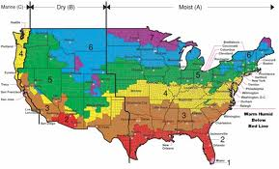
Climate
The two determining factors in climate are
Precipitation
Temperature
Turn to the map on Pp. 28-29. answer the following questions.
Which climates cover most of the following countries?
Canada
Australia
Columbia
Libya
Germany
Iran
Kenya
Ethiopia
Uruguay
Italy
Korea
Iceland

